Slide 1

Fashion Class Image Classification Using ANN
Meet Shah

Slide 2
1. PROBLEM STATEMENT AND BUSINESS CASE UNDERSTANDING
Fashion training set consists of 70,000 images divided into 60,000 training and 10,000 testing samples. Dataset sample consists of 28x28 grayscale image, associated with a label from 10 classes.
The 10 classes are as follows:
0 => T-shirt/top 1 => Trouser 2 => Pullover 3 => Dress 4 => Coat 5 => Sandal 6 => Shirt 7 => Sneaker 8 => Bag 9 => Ankle boot
Each image is 28 pixels in height and 28 pixels in width, for a total of 784 pixels in total. Each pixel has a single pixel-value associated with it, indicating the lightness or darkness of that pixel, with higher numbers meaning darker. This pixel-value is an integer between 0 and 255.

Slide 3
2. Visualization

Slide 4
This is a short description of an image on next slide.
There is not much to visualize in our data so this section will contain only 1 visualization.
It could not be fitted here. So it is uploaded separately.
This visualization is enough to represent our whole dataset.
The image is a grid of several images shown as an example of how they look like.
We have seen the full description of them in the 2nd slide.

Slide 5
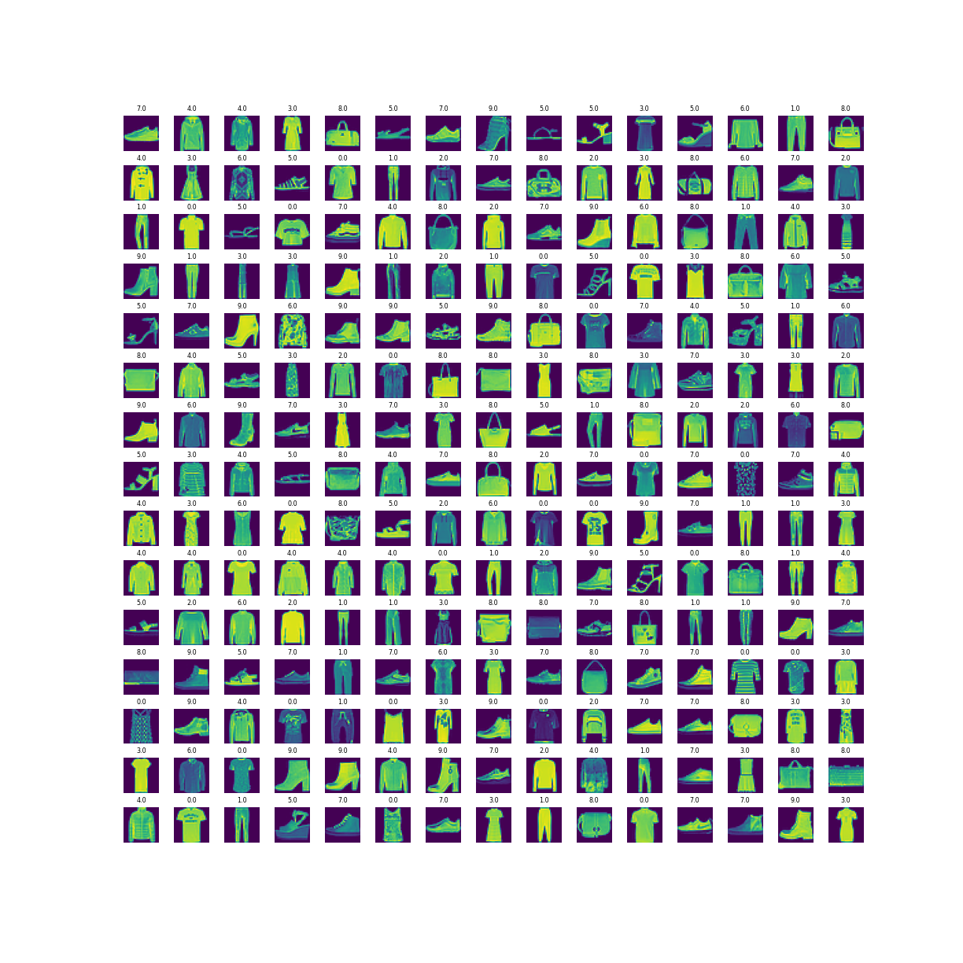

Slide 6
3. Model Building & Evaluation
The model that I have used for this dataset is Artificial Neural Network.
The steps to apply it are as follows:
1. First I applied a Convoluted filter layer with 64 filters and a kernel size of 3. The input shape was given the value of [28, 28, 1] with a relu activation.
2. Next I applied a Max Pooling to reduce the dimensions of my matrix to 2x2.
3. I used Flatten on my Max Pooling to convert it from a matrix to a single array.
4. Next I applied a Dense layer or a hidden layer which further improved my model accuracy with 32 units and a relu activation.
5. At last I applied one more Dense layer which went as the output layer of my model. It has 10 units(should equal to the number of target variables) and a sigmoid activation function.
I converted all these to a confusion matrix comparing our predicted classes vs test dataset which is shown on the next slide.

Slide 7
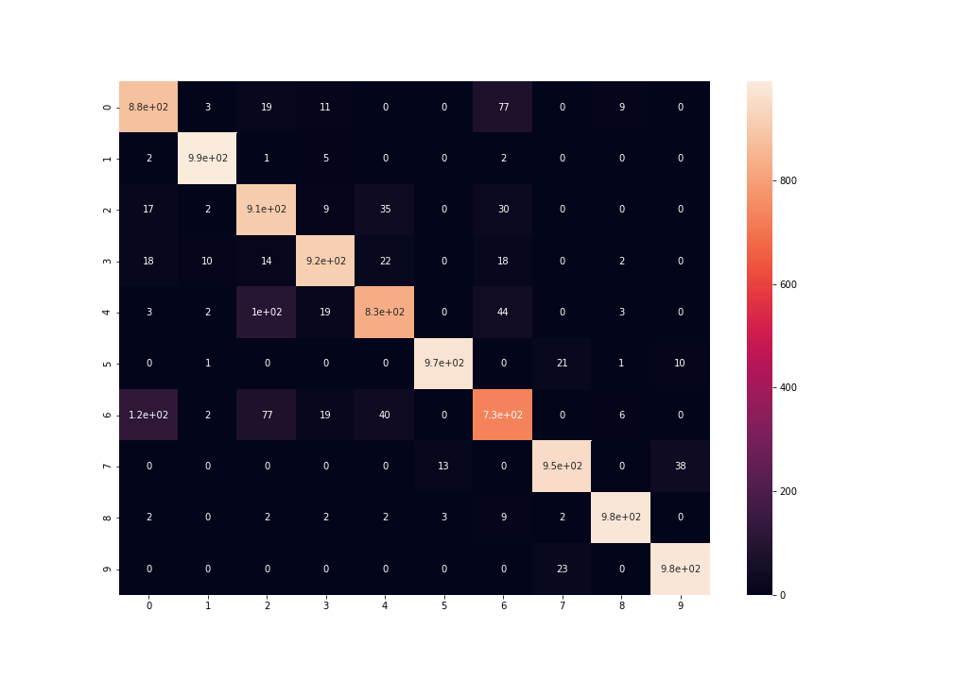

Slide 8

Conclusion
I have successfully achieved a 92% of average accuracy across my train, test and validation dataset without overfitting my model. A full classification report consisting all the 10 classes/target variables can be found in my Main notebook. So make sure to check it out.

Slide 9
Thank you

